Slide 1
React JS Learn by doing

Slide 2
Create a TIC-TAC-TOE
We will learn react js by creating TIC-TAC-TOE

Slide 3
Nodejs
What is Node.js?
Node.js is an open source server environment
Node.js is free
Node.js runs on various platforms (Windows, Linux, Unix, Mac OS X, etc.)
Node.js uses JavaScript on the server

Slide 4
Why Node.js?
Node.js uses asynchronous programming!
Node.js handles a file request:
Sends the task to the computer's file system.
Ready to handle the next request.
When the file system has opened and read the file, the server returns the content to the client.
Node.js eliminates the waiting, and simply continues with the next request.
Node.js runs single-threaded, non-blocking, asynchronously programming, which is very memory efficient.
Notes:
A common task for a web server can be to open a file on the server and return the content to the client.

Slide 5
What Can Node.js Do?
Node.js can generate dynamic page content
Node.js can create, open, read, write, delete, and close files on the server
Node.js can collect form data
Node.js can add, delete, modify data in your database

Slide 6
Getting Started with Node.js
Download nodejs from below link
https://nodejs.org/en/download/

Slide 7
Node.js http module
Node.js has a built-in module called HTTP, which allows Node.js to transfer data over the Hyper Text Transfer Protocol (HTTP).
To include the HTTP module, use the require() method:
var http = require(‘http’);
Node.js as a web server
var http = require('http'); //create a server object: http.createServer(function (req, res) { res.write('Hello World!'); //write a response to the client res.end(); //end the response }).listen(8080); //the server object listens on port 8080
Save the code above in a file called “my_http.js", and initiate the file:
node my_http.js
Notes:
The function passed into the http.createServer() method, will be executed when someone tries to access the computer on port 8080.

Slide 8
Node.js http module
Add an http header
var http = require('http'); http.createServer(function (req, res) { res.writeHead(200, {'Content-Type': 'text/html'}); res.write('Hello World!'); res.end(); }).listen(8080);
Notes:
The first argument of the res.writeHead() method is the status code, 200 means that all is OK, the second argument is an object containing the response headers.

Slide 9
Node.js http module
Read the Query String
var http = require('http'); http.createServer(function (req, res) { res.writeHead(200, {'Content-Type': 'text/html'}); res.write(req.url); res.end(); }).listen(8080);
Notes:
The function passed into the http.createServer() has a req argument that represents the request from the client, as an object (http.IncomingMessage object).
This object has a property called "url" which holds the part of the url that comes after the domain name:

Slide 10
Node.js http module
Split the Query String
There are built-in modules to easily split the query string into readable parts, such as the URL module.
var http = require('http'); var url = require('url'); http.createServer(function (req, res) { res.writeHead(200, {'Content-Type': 'text/html'}); var q = url.parse(req.url, true).query; var txt = q.year + " " + q.month; res.end(txt); }).listen(8080);
Notes:
The function passed into the http.createServer() has a req argument that represents the request from the client, as an object (http.IncomingMessage object).
This object has a property called "url" which holds the part of the url that comes after the domain name:

Slide 11
npm vs yarn
npm: It is a package manager for the JavaScript programming language. It is the default package manager for the JavaScript runtime environment Node.js. It consists of a command-line client, also called npm, and an online database of public and paid-for private packages called the npm registry.
yarn: It stands for Yet Another Resource Negotiator and it is a package manager just like npm. It was developed by Facebook and is now open-source. The intention behind developing yarn(at that time) was to fix performance and security concerns with npm.

Slide 12
npm vs yarn
Installation procedure
npm: npm is installed with Node automatically.
yarn: To install yarn npm have to be installed.
npm install yarn --global
The lock file
npm: NPM generates a ‘package-lock.json’ file. The package-lock.json file is a little more complex due to a trade-off between determinism and simplicity. Due to this complexity, the package-lock will generate the same node_modules folder for different npm versions. Every dependency will have an exact version number associated with it in the package-lock file.
yarn: Yarn generates a ‘yarn.lock’ file. Yarn lock files help in easy merge. The merges are predictable as well, because of the design of the lock file.

Slide 13
npm vs yarn
Output log
install: The npm creates massive output logs of npm commands. It is essentially a dump of stack trace of what npm is doing.
add: The yarn output logs are clean, visually distinguishable and brief. They are also ordered in a tree form for understandability.
Installing global dependencies
npm: To install a global package, the command template for npm is:npm install -g package_name@version_number
yarn: To install a global package, the command template for yarn is:yarn global add package_name@version_number
Fetching packages
npm: npm fetches dependencies from the npm registry during every ‘npm install‘ command.
Yarn: yarn stores dependencies locally, and fetches from the disk during a ‘yarn add‘ command (assuming the dependency(with the specific version) is present locally).

Slide 14
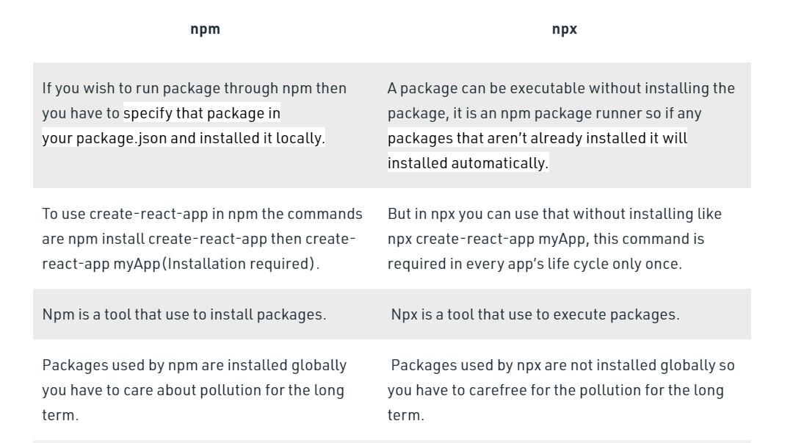
npm vs npx

Slide 15
Set up Local Development Environment
Make sure you have a recent version of Node.js installed.
https://nodejs.org/en/download/
npx create-react-app my-app
Delete all files in the src/ folder of the new project
# Go project folder
cd my-app
cd src
del *
# Then, switch back to the project folder
cd ..
Add a file named index.css in the src/ folder with this CSS code.
Add a file named index.js in the src/ folder with this JS code.
Add these three lines to the top of index.js in the src/ folder:

Slide 16
Set up Local Development Environment(contd..)
Add these three lines to the top of index.js in the src/ folder:
import React from 'react';
import ReactDOM from 'react-dom';
import './index.css';
Now if you run npm start in the project folder and open http://localhost:3000
in the browser, you should see an empty tic-tac-toe field.

